Slide 1

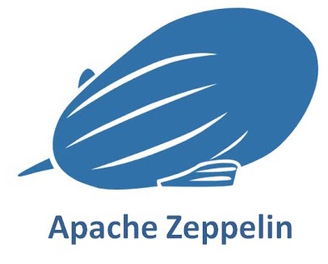
Zeppelin Tutorials
Beyond The Basics
Presents
with
Abhijeet V Rajput

Slide 2
What is Zeppelin Notebooks
Zeppelin Notebooks, A completely open web-based notebook that enables interactive data analytics.
Zeppelin provides a “Modern Data Science Studio” that supports Spark and Hive out of the box. Actually, Zeppelin supports multiple language backends which has support for a growing ecosystem of data sources. Zeppelin’s notebooks provides interactive snippet-at-time experience to data scientist.
Zeppelin interpreter concept allows any language/data-processing-backend to be plugged into Zeppelin. Currently Zeppelin supports many interpreters such as Scala(with Apache Spark), Python(with Apache Spark), SparkSQL, Hive, Markdown and Shell.

Slide 3
Features
Currently Zeppelin supports many interpreters such as Scala(with Apache Spark), Python(with Apache Spark), SparkSQL, Hive, Markdown and Shell.
Some basic charts are already included in Zeppelin. Visualizations are not limited to SparkSQL's query, any output from any language backend can be recognized and visualized.
Zeppelin can dynamically create some input forms into your notebook.
Notebook URL can be shared among collaborators. Zeppelin can then broadcast any changes in real-time, just like the collaboration in Google docs.
Zeppelin provides an URL to display the result only, that page does not include Zeppelin's menu and buttons. This way, you can easily embed it as an iframe inside of your website.

Slide 4
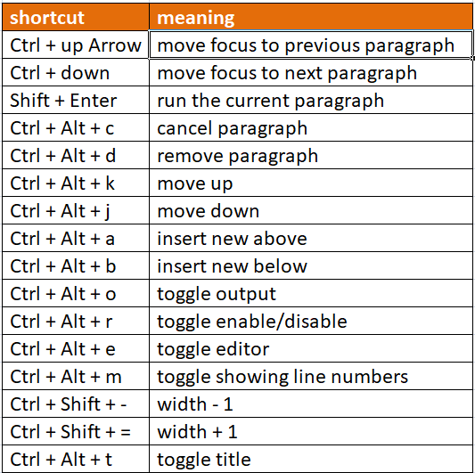

Slide 5
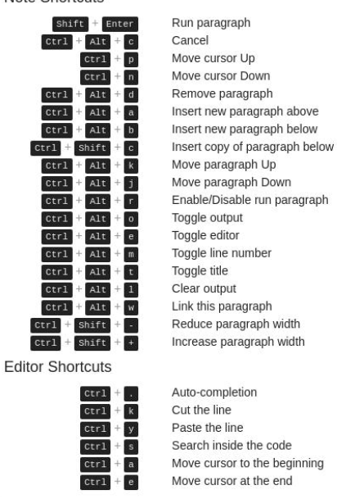

Slide 6
Zeppelin Notebook cheat sheet

Slide 7

